Slide 1

ECHO MUSIC PLAYER
Project Progress Presentation : Milestone 3
Date: 18/02/2021
PROJECT WORK PHASE - II (ECS899)
Degree : B.Tech (CSE)
Project Guide:
Mr. Rupal Gupta
Group: ECSP-06
Manish Gupta (TCA1709110)
FACULTY OF ENGINEERING AND COMPUTING SCIENCES
TEERTHANKER MAHAVEER UNIVERSITY, MORADABAD

Slide 2

Project Milestones
S# | Milestone | Planned Date | Actual Date | Inputs Required
1 | Project Synopsis Presentation | 25/09/2020 | 25/09/2020 | Project Synopsis Report (using Template T001) should be ready and available
2 | Requirement Analysis | 15/11/2020 | 08/11/2020 | Project Synopsis Report Project Report (using Template T003) –Section on “Requirement Analysis” should be ready and available
3 | Live Demo (with 50% completion) | 19/03/2021 | 18/02/2021 | Project Synopsis Report Project Report Live Project (in 50% working condition) should be ready and installed in Lab Server Test Cases
4 | Final Demo | DD/MM/YYYY | DD/MM/YYYY | Project Synopsis Report Project Report (Completed) Live Project -100% completed
5 | Project Viva (External) | - | - | Date will be published by CCSIT
2
T004/ Version 1.0

Slide 3
Technologies and Tools to be used
  Software Platform
Front-end
XML
Back-end
Kotlin
SQLite
Hardware Platform
RAM : at least 256 MB of RAM
Hard Disk : at least 10 MB of Disk Space on Hard Disk
OS : Android Operating System
IDE : Android Studio v1.0
  Tools
Tool Name: Android Studio IDE
Version: 1.0
Developer(s): Google Inc.
Written in: Java, Kotlin, C++
3
T002/ Version 1.0

Slide 4
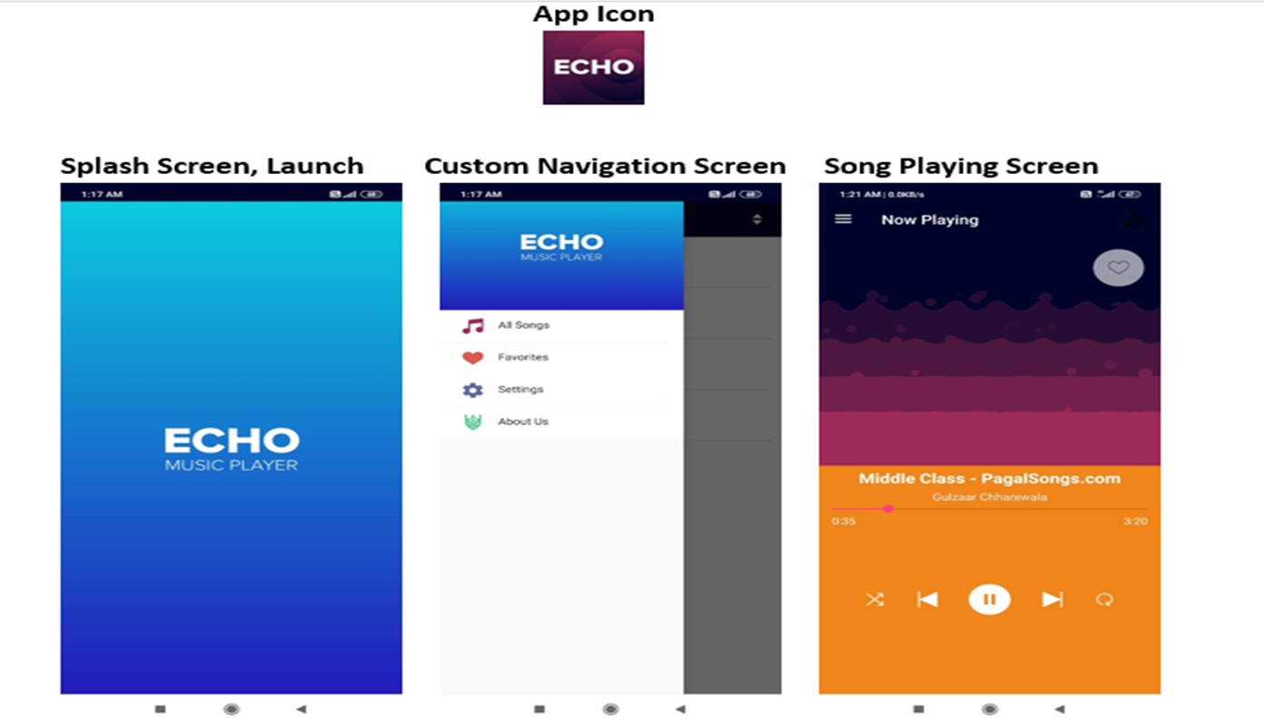
Artifacts and Screens of Running Application
4
T004/ Version 1.0

Slide 5
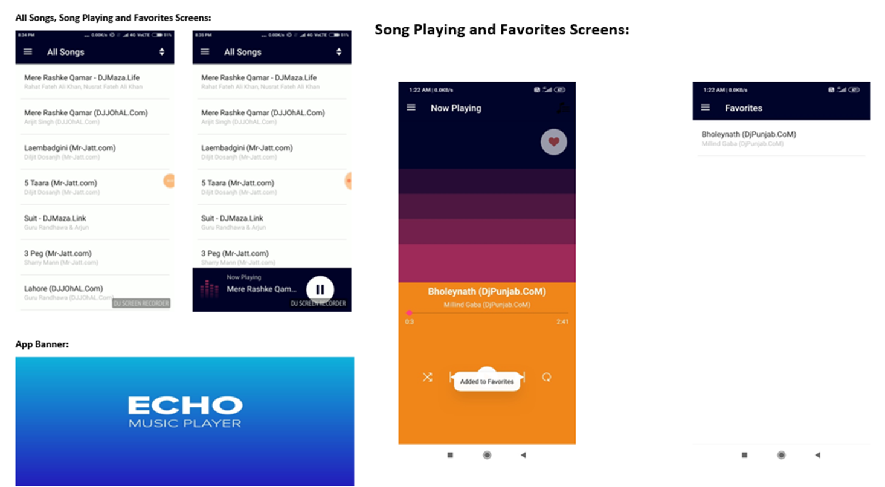
Artifacts and Screens of Running Application
5
T004/ Version 1.0

Slide 6
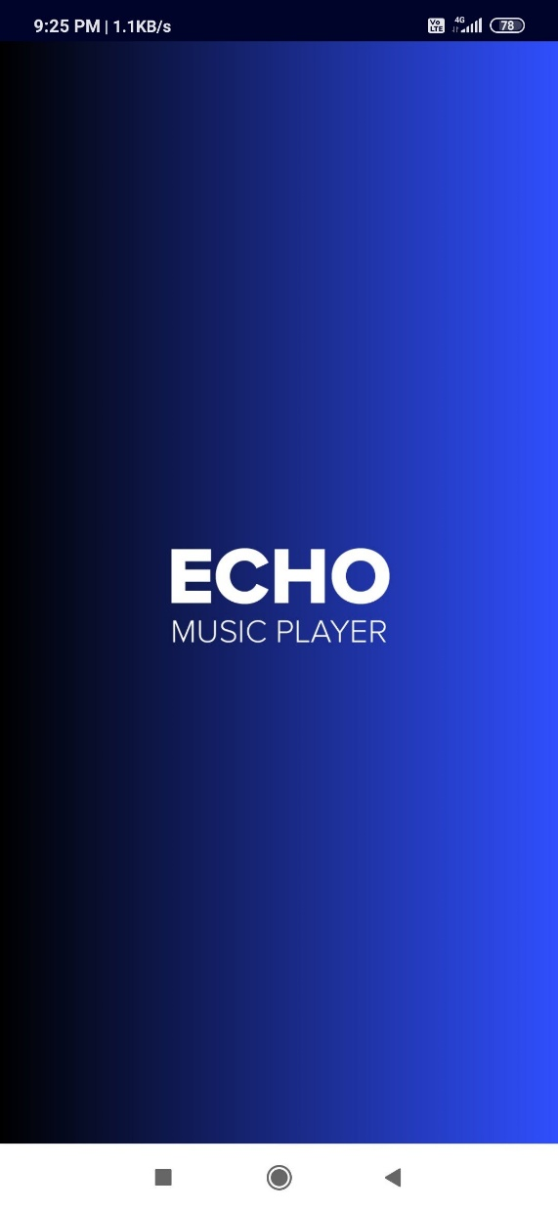
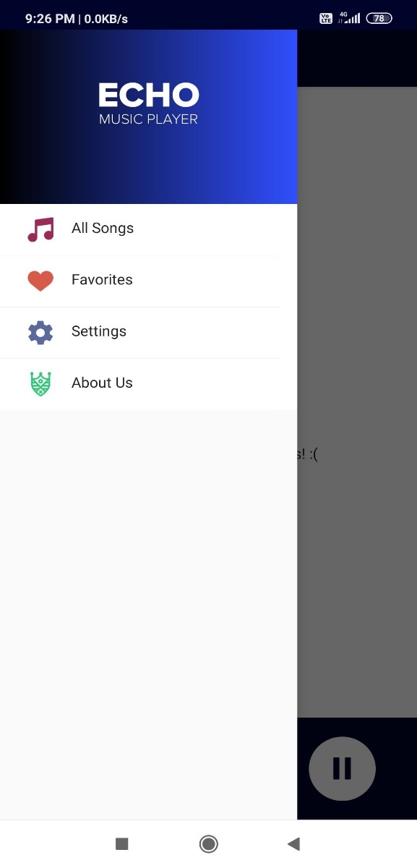
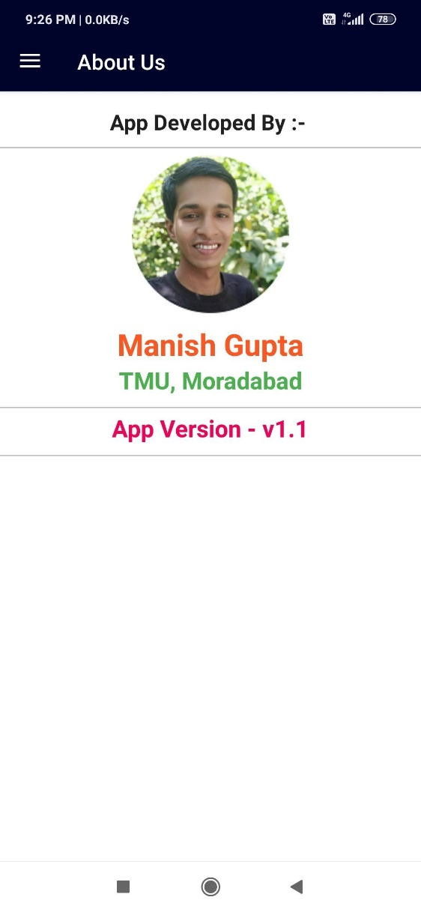

Artifacts and Screens of Running Application
6
T004/ Version 1.0

Slide 7
Context Diagram (Overall Project)
7
T002/ Version 1.0

Slide 8
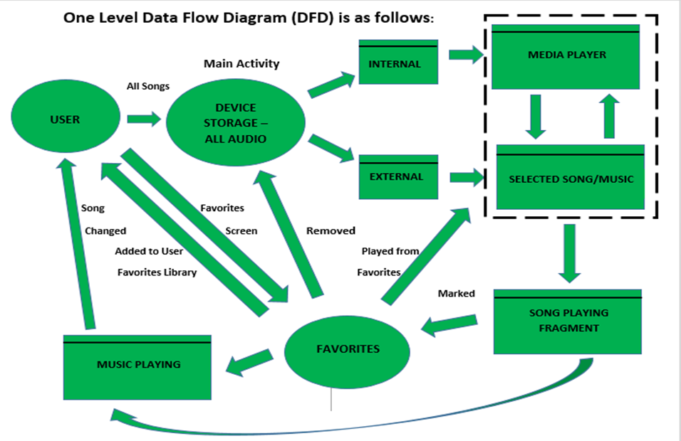
Data Flow Diagram (DFD)
8
T002/ Version 1.0

Slide 9

End of Project Progress Presentation

